Slide 1
Applied Data Science Portfolio
Jaya Varshini Prabakar
SUID: 463948991

Slide 2

Project 1 Health Care Cost Information Analysis
Problem Statement:
What is considered expensive?
How can an HMO identify expensive clients?
How to reduce cost for HMO?

Slide 3
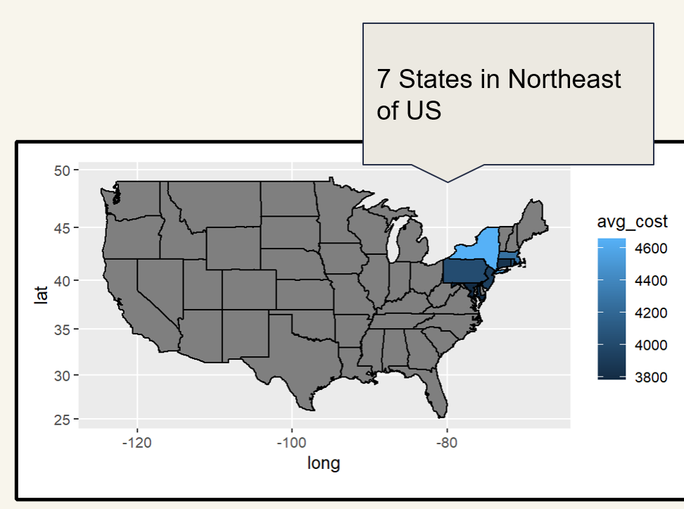
Dataset
Data Structure
7582 observations and 14 variables
Variable Category:
* Numeric Variable: Age, bmi, children, cost
Categorical Variable: X(ID),smoker, location, location_type, education_level, yearly_physical, exercise, married, hypertension, gender
Target Variable: Cost -> Expensive Case

Slide 4
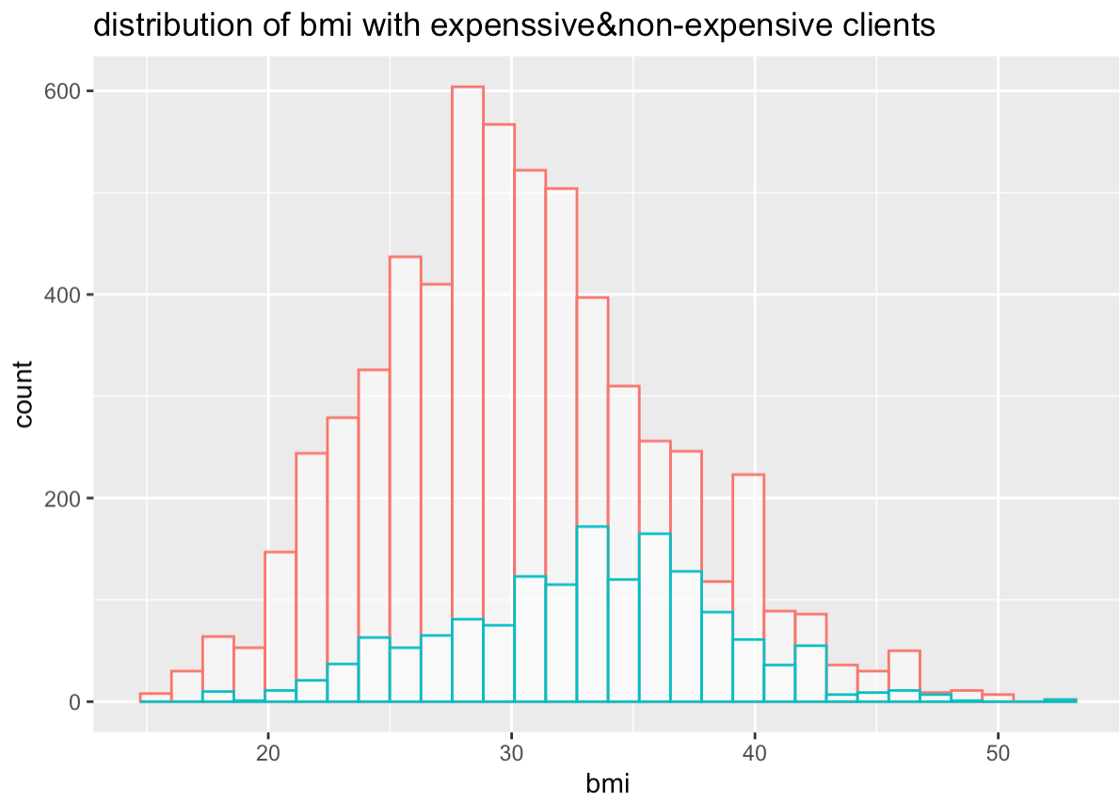
Histogram - BMI with Expensive
Count(X-axis) vs BMI(Y-axis)
Red bar is more concentrated and have major peaking(mean) at 26 - 28 BMI index which means that more number of non-expensive clients are Overweight and when looking at the blue bar , it is majorly concentrated and has peaking (mean) at 34-36 BMI index which means that more number of expensive clients are having the problem of Obesity

Slide 5
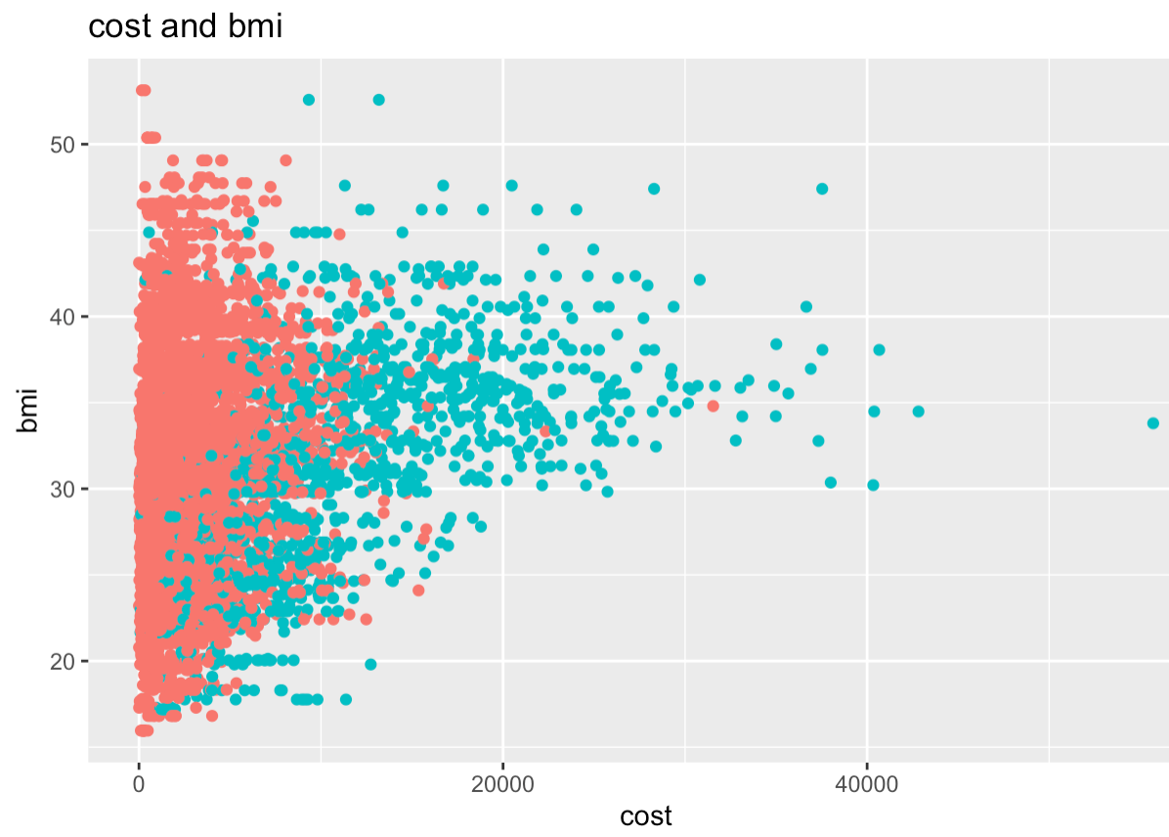
ScatterPlots - Cost & Bmi & Smoking
Comparison between Cost, BMI and Smoking.
In the above scatterplot, we have tried to determine a possible relationship between variables Smoker, BMI and Cost. According to healthcare experts, A healthy BMI value lies between 18.5 to 24.9. As per the graph, a person who has a higher BMI, and who is also a smoker, has a higher probability of being an expensive candidate for the HMO.

Slide 6
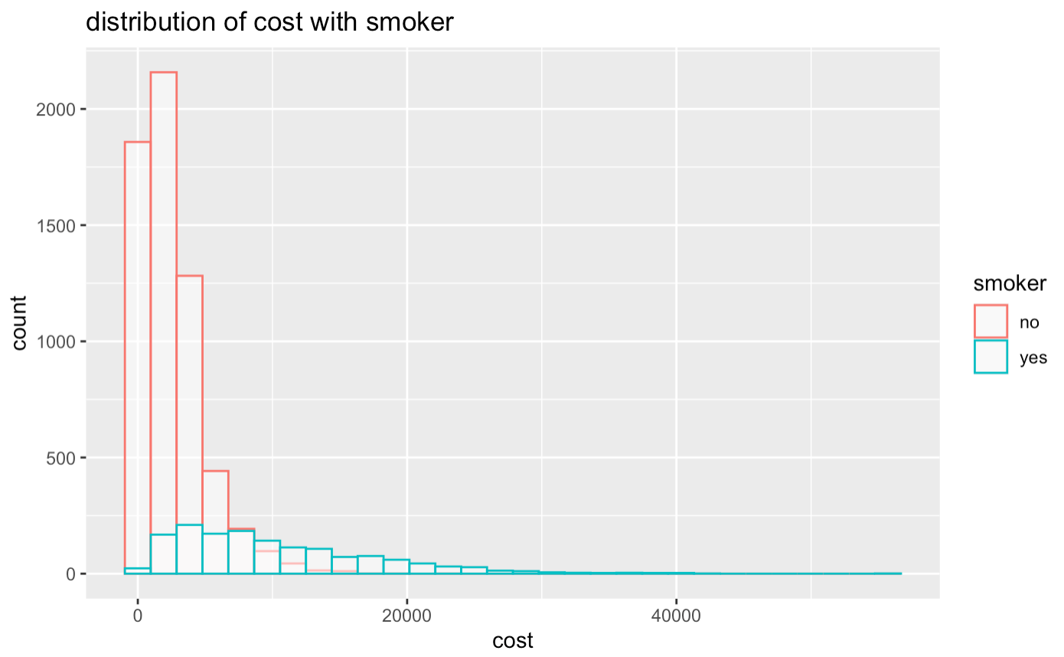
Histogram - Cost & Smoking
Comparison between Cost, Count and Smoking.
In this graph , X-axis represents the count of people and Y-axis represents the cost we can see that the Red Bar depicts the number of Non-Smokers and Blue Bar depicts the number of Smokers.
We can infer that the cost is low for the Non-Smokers and at the same time the count is high and cost increases for the people who smoke.

Slide 7
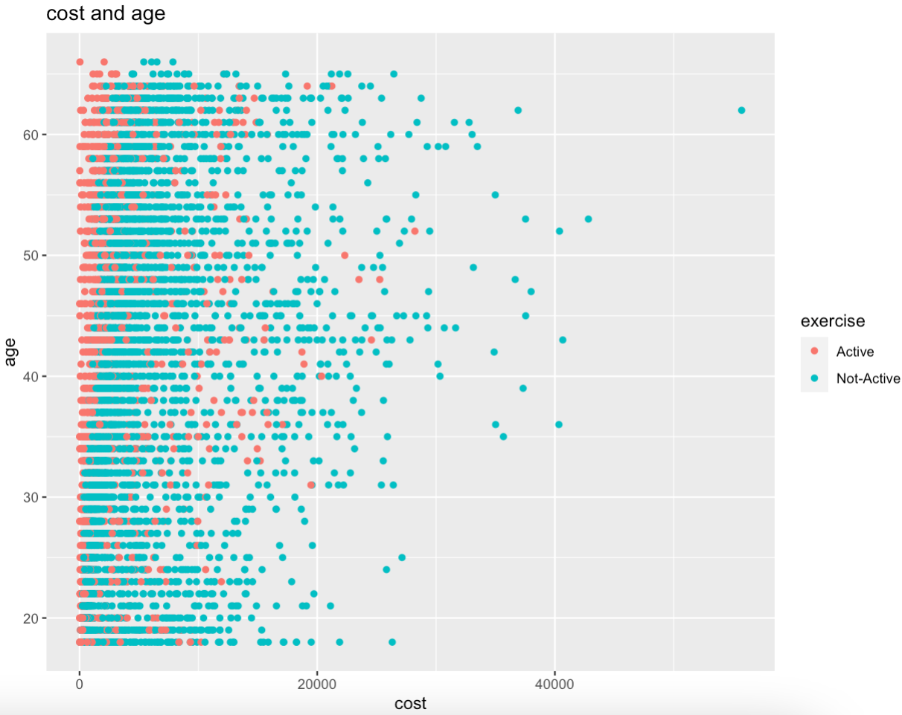
Scatter Plot - Cost & Age & Exercise
Age (x-axis) vs Cost (y-axis)
In this graph X- Axis represents the Age and Y-axis represents the Cost .
We can infer that the People who are not active , end up spending more amount of money for their health related issues and people who are active and healthy need not spend more money.

Slide 8


Predictive Model

Slide 9

Data Analysis Process
We used several Machine Learning techniques and identified a model which has the highest prediction rate.
Some of the techniques we used are:
- Linear Regression - Logistic regression - Decision Trees
- Neural Network - Random Forests - Support Vector Machines - Association Rules
Engaging with all information from data visualization and
predictive models: age, bmi, children, smoking, exercise,
yearly physical check, hypertension

Slide 10
Actionable Insight

Slide 11

Conclusion
Age has a positive impact on the cost, which means the older clients have a higher possibility of being expensive clients.
Higher BMI also leads to higher costs.
Individuals who are less active also have a high possibility of having high healthcare costs.
Medical expenses are generally higher for patients who smoke, have hypertension, do not exercise, and do not have regular physical examinations.

Slide 12

Recommendations
Since customers with certain habits are more prone to health problems, it is useful to identify such customers through health survey forms and recommend a low, medium or high premium plan accordingly.
Set marketing campaign about educational information on the harmness of smoking and benefit of exercise
It will be helpful to provide services such as annual checkup reminders, as early detection is important to reduce future healthcare costs.
Collaborations with major fitness platforms will help improve people's overall health and reduce the risk of healthcare costs, thus saving money for the HMO.
Offering family plans at a slightly lower rate is beneficial for the HMO because it is unlikely that all members of the family will experience health problems at the same time.

Slide 13
Learning Outcomes
Create
Create actionable insight across a range of contexts (e.g. societal, business, political), using data and the full data science life cycle
Communicate
Communicate insights gained via visualization and analytics to a broad range of audiences (including project sponsors and technical team leads
Apply
Apply ethics in the development, use and evaluation of data and predictive models (e.g., fairness, bias, transparency, privacy)

Slide 14
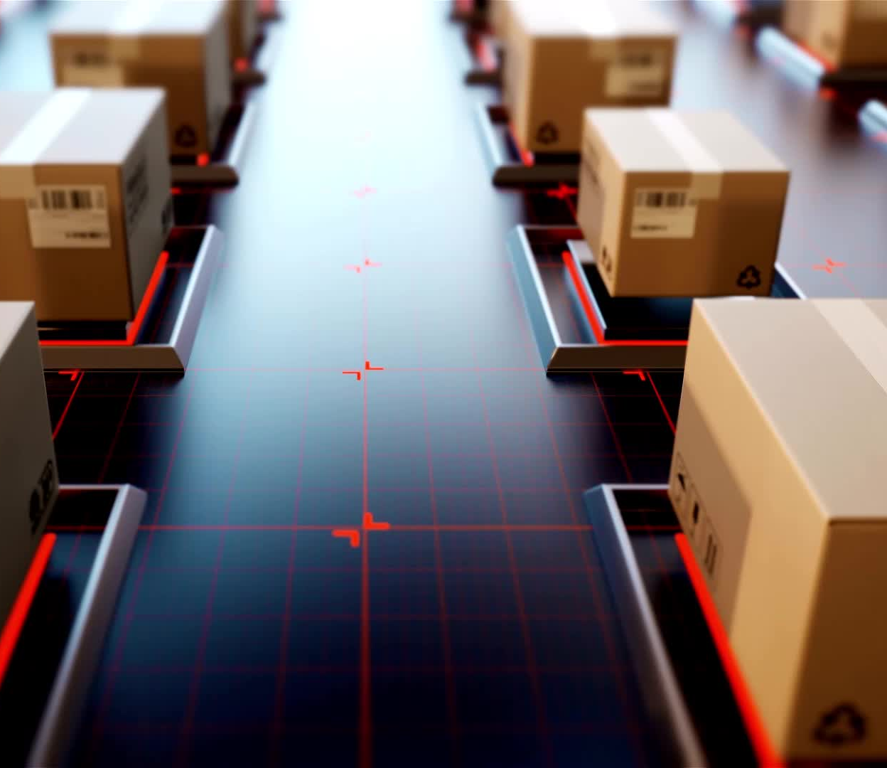
Project 2 FudegeInc Data Warehouse Implementation

Slide 15

Project Description
To create a Datawarehouse that merges two business entities one is Fudgemart which is a retail business enterprise, and the other is FudgeFlix which is a rental DVD store.
With the merged Datawarehouse we have to create a MOLAP (Multidimensional online Analytical Processing) cube which serves as the input for PowerBI dashboard

Slide 16
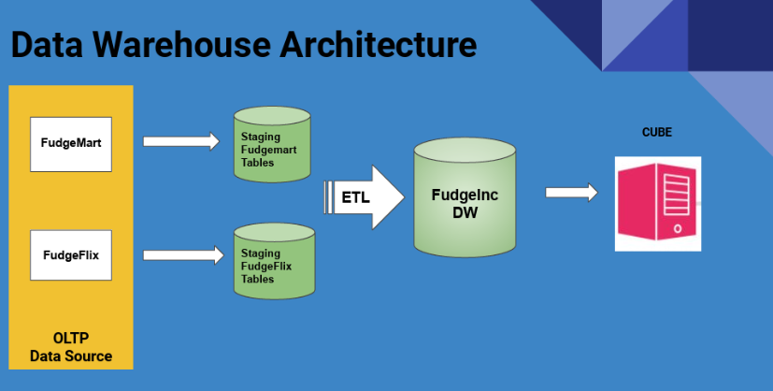

Slide 17
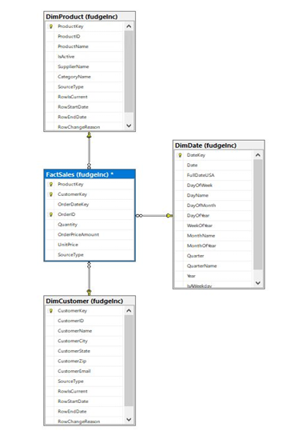
STAR SCHEMA Fact table: FactSales Dimension tables: DimProduct, DimDate, DimCustomer. Advantages: Performance: This star schema improves performance Simplicity: Easy to understand and write queries for

Slide 18
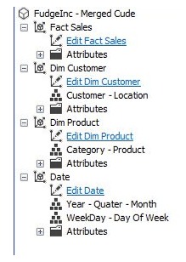
OLAP Cube
Why a OLAP Cube?
Serves a Multidimensional platform which helps to combine data into organized structures making it easy for analysis
Fast Performance in terms of Query helping in aggregating data quickly. navigate intuitively.
Hierarchical Relationships making it easy for users.

Slide 19
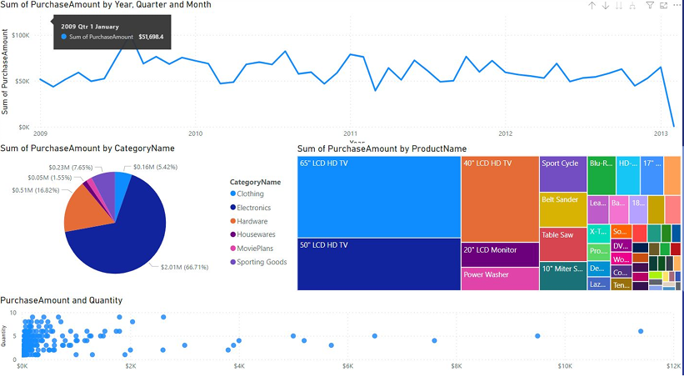
Visual Analysis

Slide 20
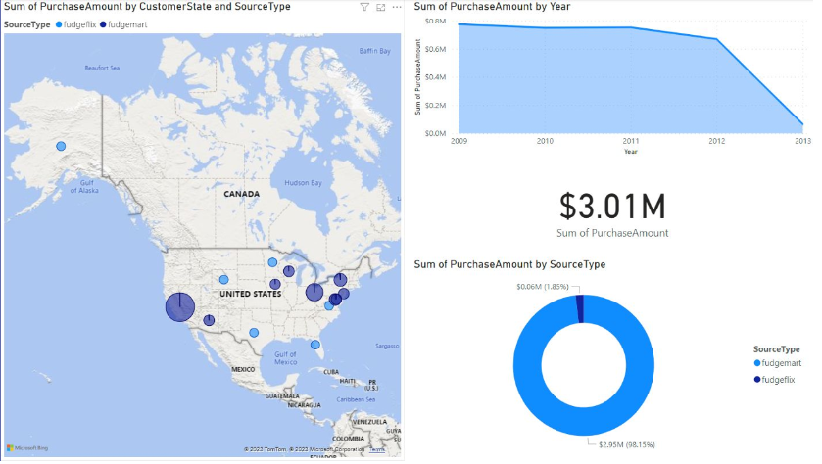

Slide 21

Recommendations
Based on OLTP
The OLTP Sources - especially FudgeMart must improve their customer city conventions. We can notice that city “Cleves” is mapped in Germany. There is no indication whether customers are worldwide or exclusive to the USA.
Based on Visual Analytics
We could see the overall sales revenue shows a downward trend over the years. FudgeInc has to optimize the pricing strategy. Strategies like focus on high demand products ,discontinuing underperforming ones and understanding the market trends might help.
We observe a downward trend on sales during Q4. Solution is to try marketing discounts, promotions and advertising strategies. Like Holiday themed products/bundles, Early bird promotions etc

Slide 22
Learning Outcomes
Collect, store, and access data by identifying and leveraging applicable technologies using the datawarehouse designing process
Create actionable insight across a range of contexts (e.g. societal, business, political), using data and the full data science life cycle- this is achieved by the PowerBI dashboard visualization which gave recommendations to the stakeholders.

Slide 23
Project 3 Los Angeles Crime Analysis Dashbord
Project Description:
A tableau dashboard that focuses on crime in Los Angeles city, the projects gives a clear insight on victims affected, type of crime and area of crime. This dashboard will be helpful resource for entities like the Department of police, City government and also for the people who are in LA or planning to move to LA.
Dataset used: https://data.lacity.org/Public-Safety/Crime-Data-from-2020-to-Present/2nrs-mtv8

Slide 24
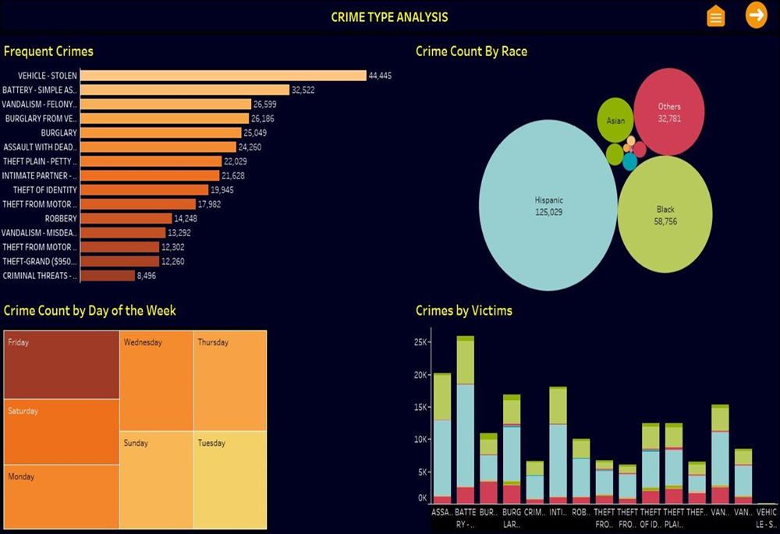
Dashboard 1:

Slide 25
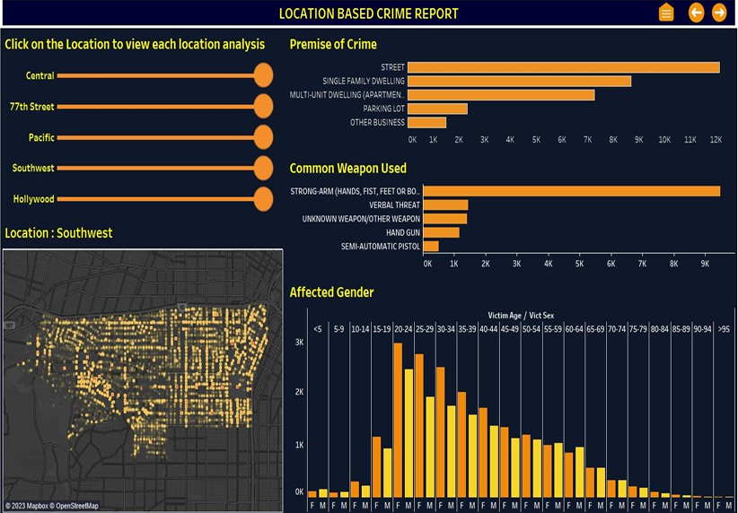
Dashboard 2:

Slide 26
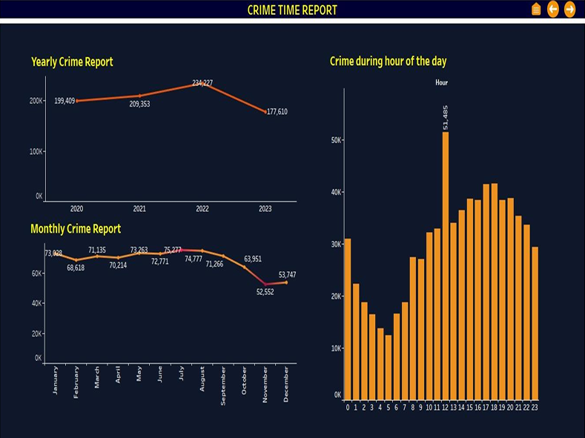
Dashboard 3:

Slide 27
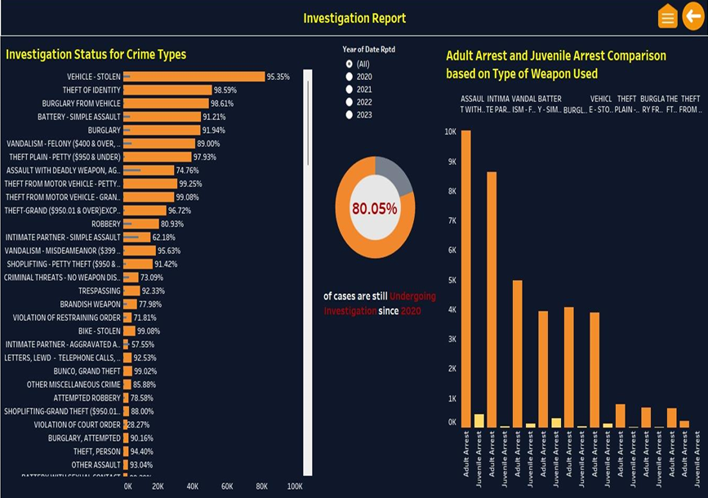
Dashboard 4:

Slide 28
Learning Outcomes
Communicate insights gained via visualization and analytics to a broad range of audiences (including project sponsors and technical team leads.
Apply visualization and predictive models to help generate actionable insight.

Slide 29
Project 4 Lacrosse Team Data Pipeline
Project Description:
This datapipeline focuses on processing a Lacrosse game’s live data, that creates box score and updates the database tables when game is over.
Databases:
• mssql : Microsoft SQL Server Database that stores player and teams reference data. The database is called ‘sidearm’ and the tables are ‘players’ and ‘teams’.
• minio: An S3 compatible object store that contains the live gamestream data. It is stored in minio/gamestreams bucket.
• mongodb – A mongodb database that stores the game streams real-time box store so the web developers can create a page from the data. The box score is written to mongo/sidearm/boxscores collection.

Slide 30
Analytical Tools Used
• drill - An instance of Apache Drill that can be used to query the databases. The drill-storage-plugins folder contains the configuration files for the databases. You will need to modify these with specifics for them to work.
• jupyter - An instance of Jupyter Lab that can be used to write PySpark code. The work folder contains the Start.ipynb that demonstrates the base spark configuration.

Slide 31

Problem Statement
The objective is to create a data pipeline which processes a simplified version of an in-game stream from a simulated a lacrosse game. The game stream has been simplified to only process goals scored. There are two parts to this problem:
At any point while the game is in progress, the game stream should be converted into a JSON format so the web developers can use it to create a box score page on a website. This JSON should be written to the mongodb/sidearm/boxscores collection, and should contain all the data necessary to display the box score page
When the game is over, the player and team reference data should be updated to reflect the team records and player statistics after the competition has ended. Normally you would update the mssql tables, but for this exam you will create new tables with the updated data, players2 and teams2 respectively. This is mostly because spark does not support row-level updates. In a real world scenario, you would write an SQL script on mssql to update the tables. from the changes in the players2 and teams2 tables, but that is outside the scope of this exam.

Slide 32
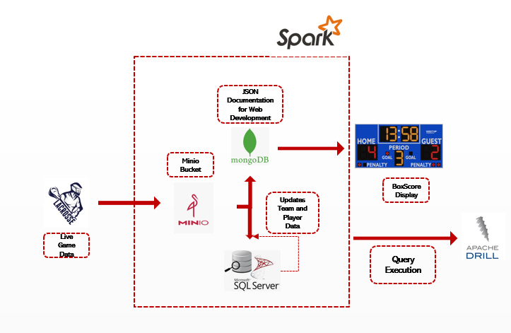
Datapipeline Constructed

Slide 33
Learning Outcomes
Collect, store, and access data by identifying and leveraging applicable technologies
Create actionable insight across a range of contexts (e.g. societal, business, political), using data and the full data science life cycle
Use programming languages such as R and Python to support the generation of actionable insight

Slide 34

Thank you!!

